Slide 1

Problem Solving Session
The remainder of today’s class will comprise the problem solving session (PSS).
Your instructor will divide you into teams of 3 or 4 students.
Each team will work together to solve the following problems over the course of 20-30 minutes.
You may work on paper, a white board, or digitally as determined by your instructor.
You will submit your solution by pushing it to GitHub before the end of class.
Your instructor will go over the solution before the end of class.
If there is any time remaining, you will begin work on your homework assignment.
Class participation is a significant part of your grade (20%). This includes in class activities and the problem solving session.
Your Course Assistants will grade your participation by verifying that you pushed your solutions before the end of the class period each day.

Slide 2

Problem Solving Team Members
Record the name of each of your problem solving team members here.
Do not forget to add every team member’s name! Your instructor (or course assistant) may or may not use this to determine whether or not you participated in the problem solving session.

Slide 3
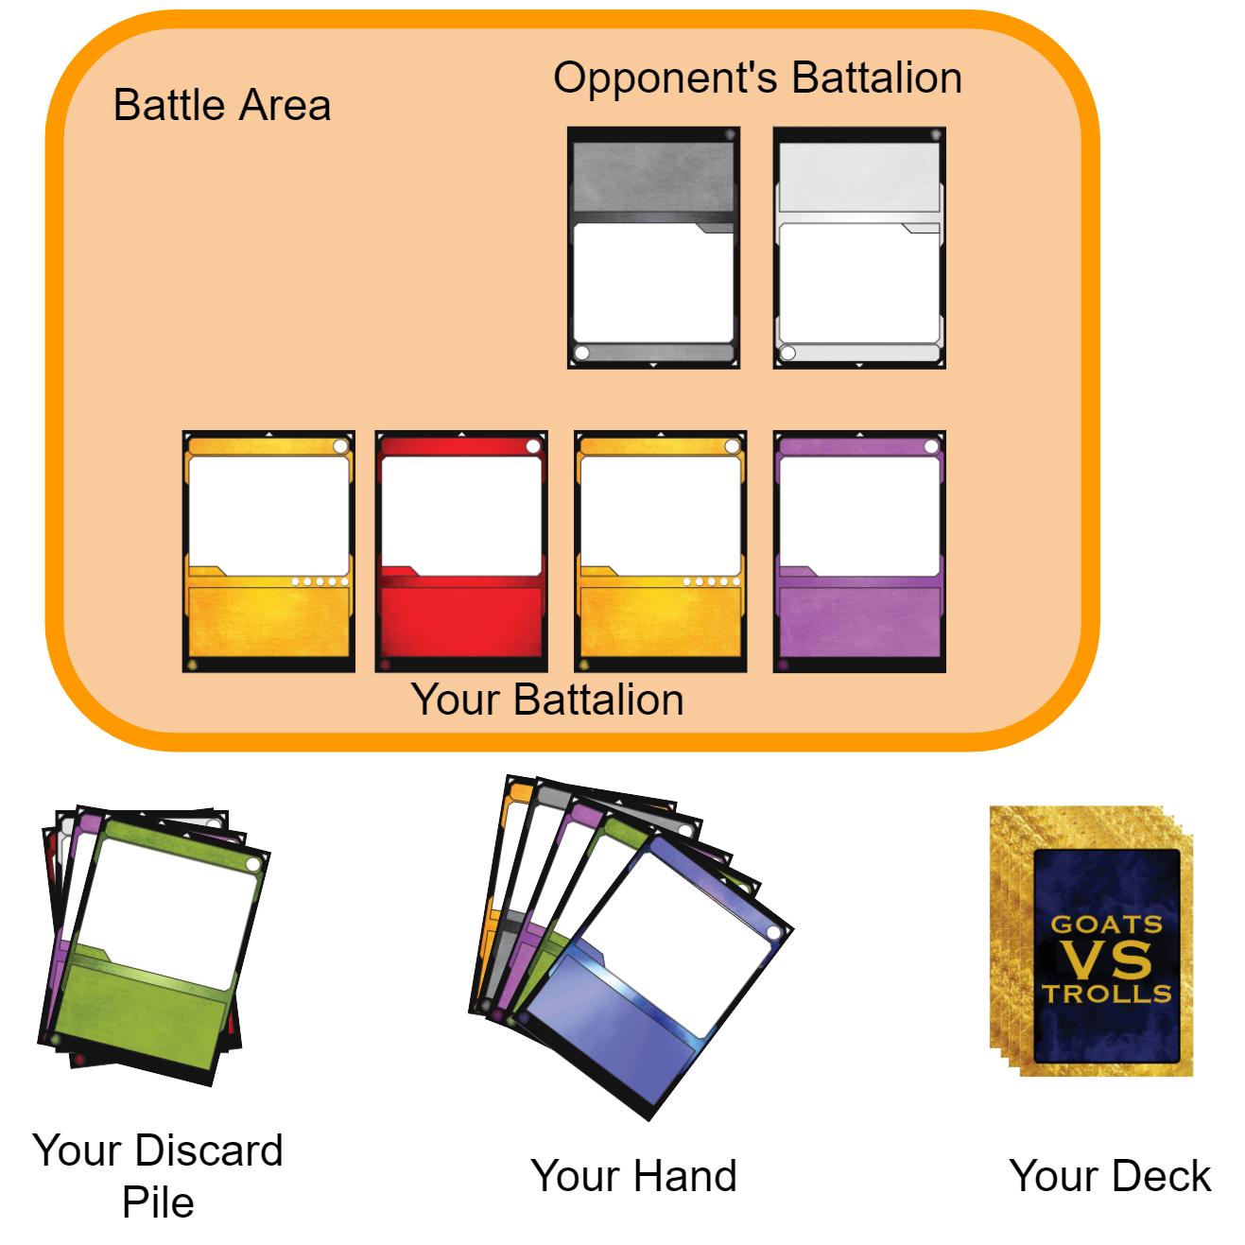
Goats vs. Trolls
Goats vs. Trolls is a CCG in which two players battle until one or both scores are reduced to 0.
The game ends in a draw if both players reach a score of 0 in the same round.
Otherwise, the loser is the player whose score reaches 0 first.
During the game players:
Draw cards from a deck into their hand.
Spend resource points to play cards from their hand into their battalion.
Battalions do battle and damage each other.
Cards defeated in battle are discarded.
Any extra damage is dealt to the player's score.
Cards also have powers that are activated.
Some powers only activate under certain circumstances.
Some powers are single use.
The layout of a Goats vs. Trolls game from the perspective of one player. You will implement methods that allow players to draw, play, and discard cards as well as do battle.

Slide 4
Problem Solving 1
RARITY_CODES = { 1:"C", 2:"U", 3:"R", 4:"L" }
We have written lots of print functions that print the fields inside of a class. But what we would rather do is pass an instance of the class directly into the built-in print() function. This requires implementing the __str__ method in the class.
Write the card class's implementation of the __str__ method to return a compact, single line string representation of the card in the format:
[RP RC HP AP]
Remember that you may want to print more than one card on the same line, so don't use newlines. You also don't need to worry about ANSI color codes. You can use "{:0>2d}".format(number)" to make sure that a number is two digits.

Slide 5
Problem Solving 2
Write the method that will be called if the == operator is used to compare two cards to each other. Two cards are considered equal if they have the same rarity, power, cost, maximum health, and attack power. Any other stats are ignored.
Remember that two instances of the same class can see each other's private fields.

Slide 6
Problem Solving 3
Write the method(s) that make cards sortable. Cards should be sorted first by rarity first, then resource cost.
Remember that two instances of the same class can see each other's private fields.

Slide 7
Problem Solving 4
Currently, instances of the card class are not hashable. Write the method necessary to make a card hashable. Remember that a good hash function must:
Be fast
Be consistent
Minimize collisions
When considering which field(s) to use, note that two cards that are equal should also return the same hash code.

